Slide 1
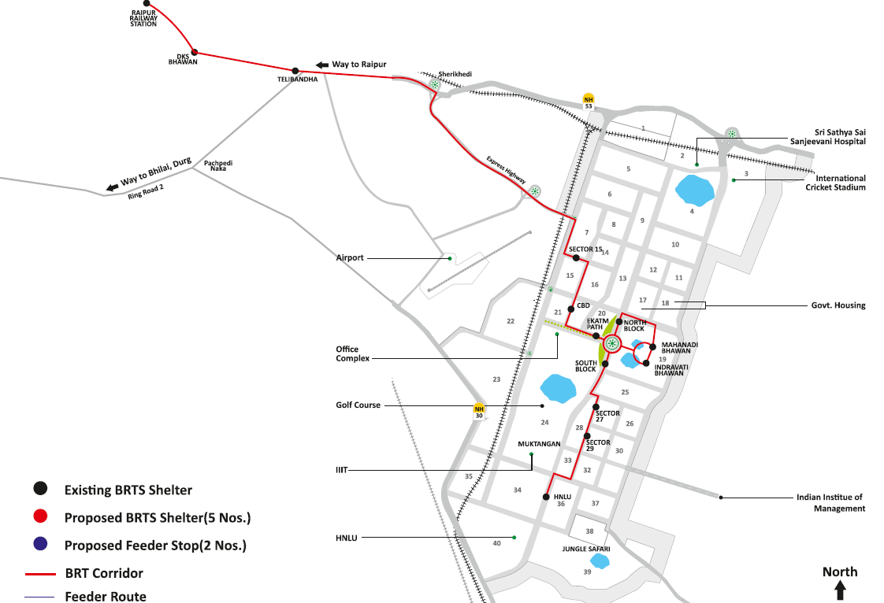
BRTS Route Map
Nawagaon
Satya Sai Hospital
Sector 17
Muktangan
IIIT
BRTS Shelter
BRTS Shelters
BRT Corridor 1
Feeder Loop 1 (Ext. Corridor 1)
Feeder Loop 2
Vednata Hospital
HNLU Gate
8
Jungle Safari

